Slide 1
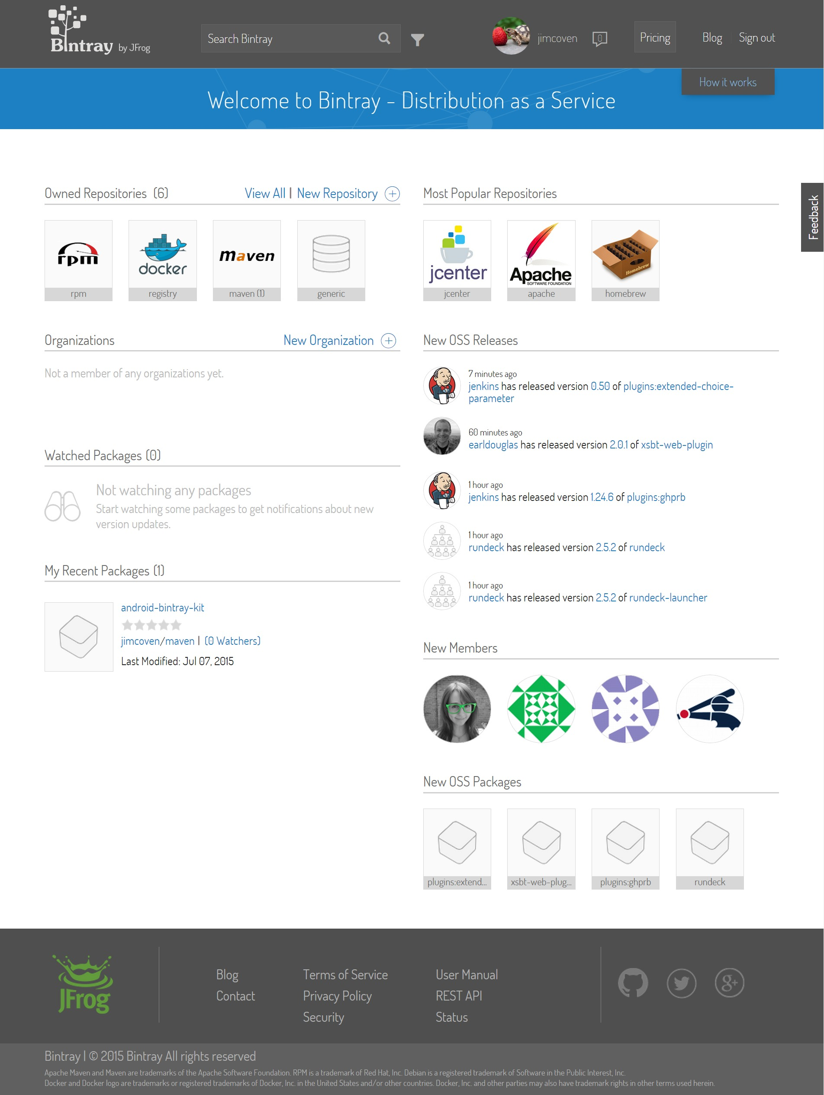
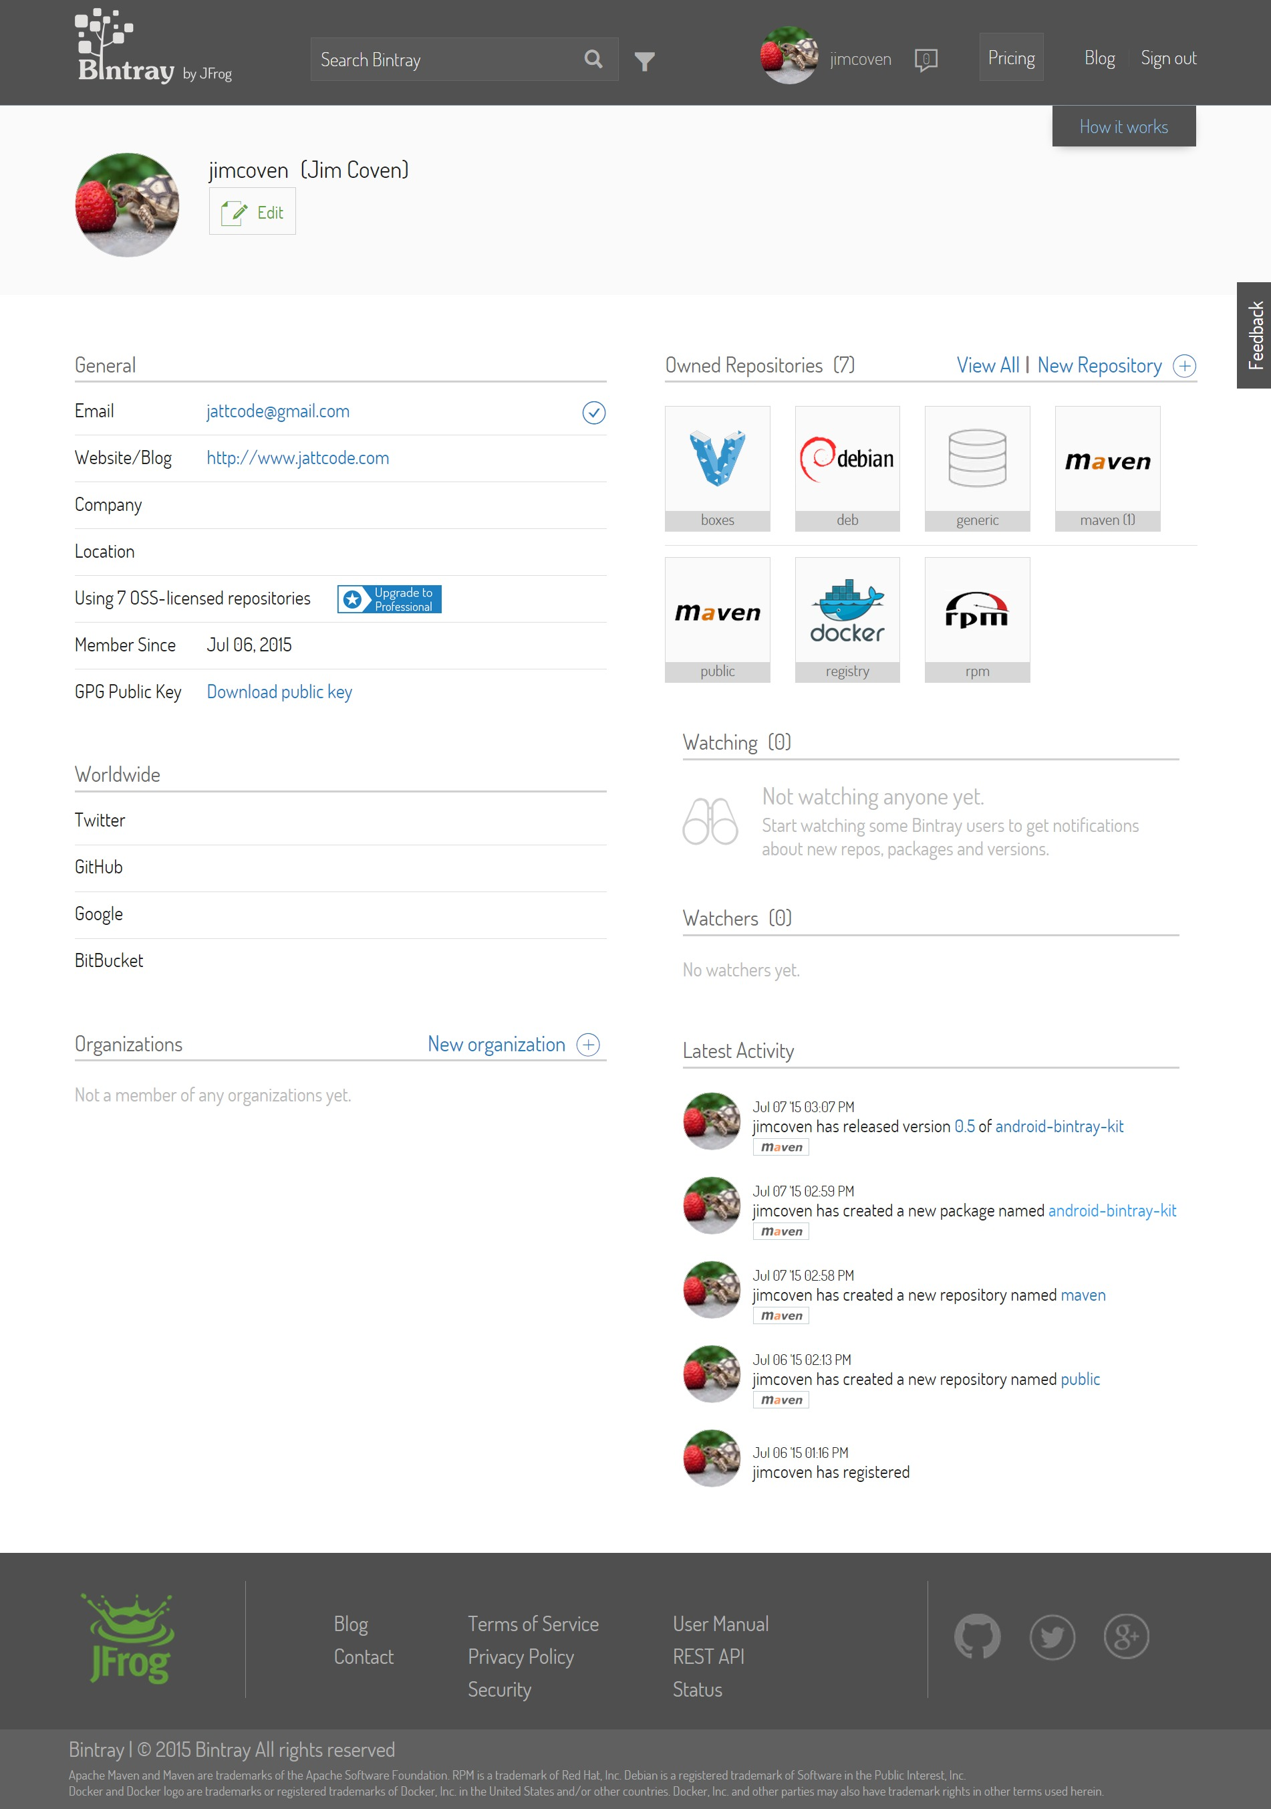
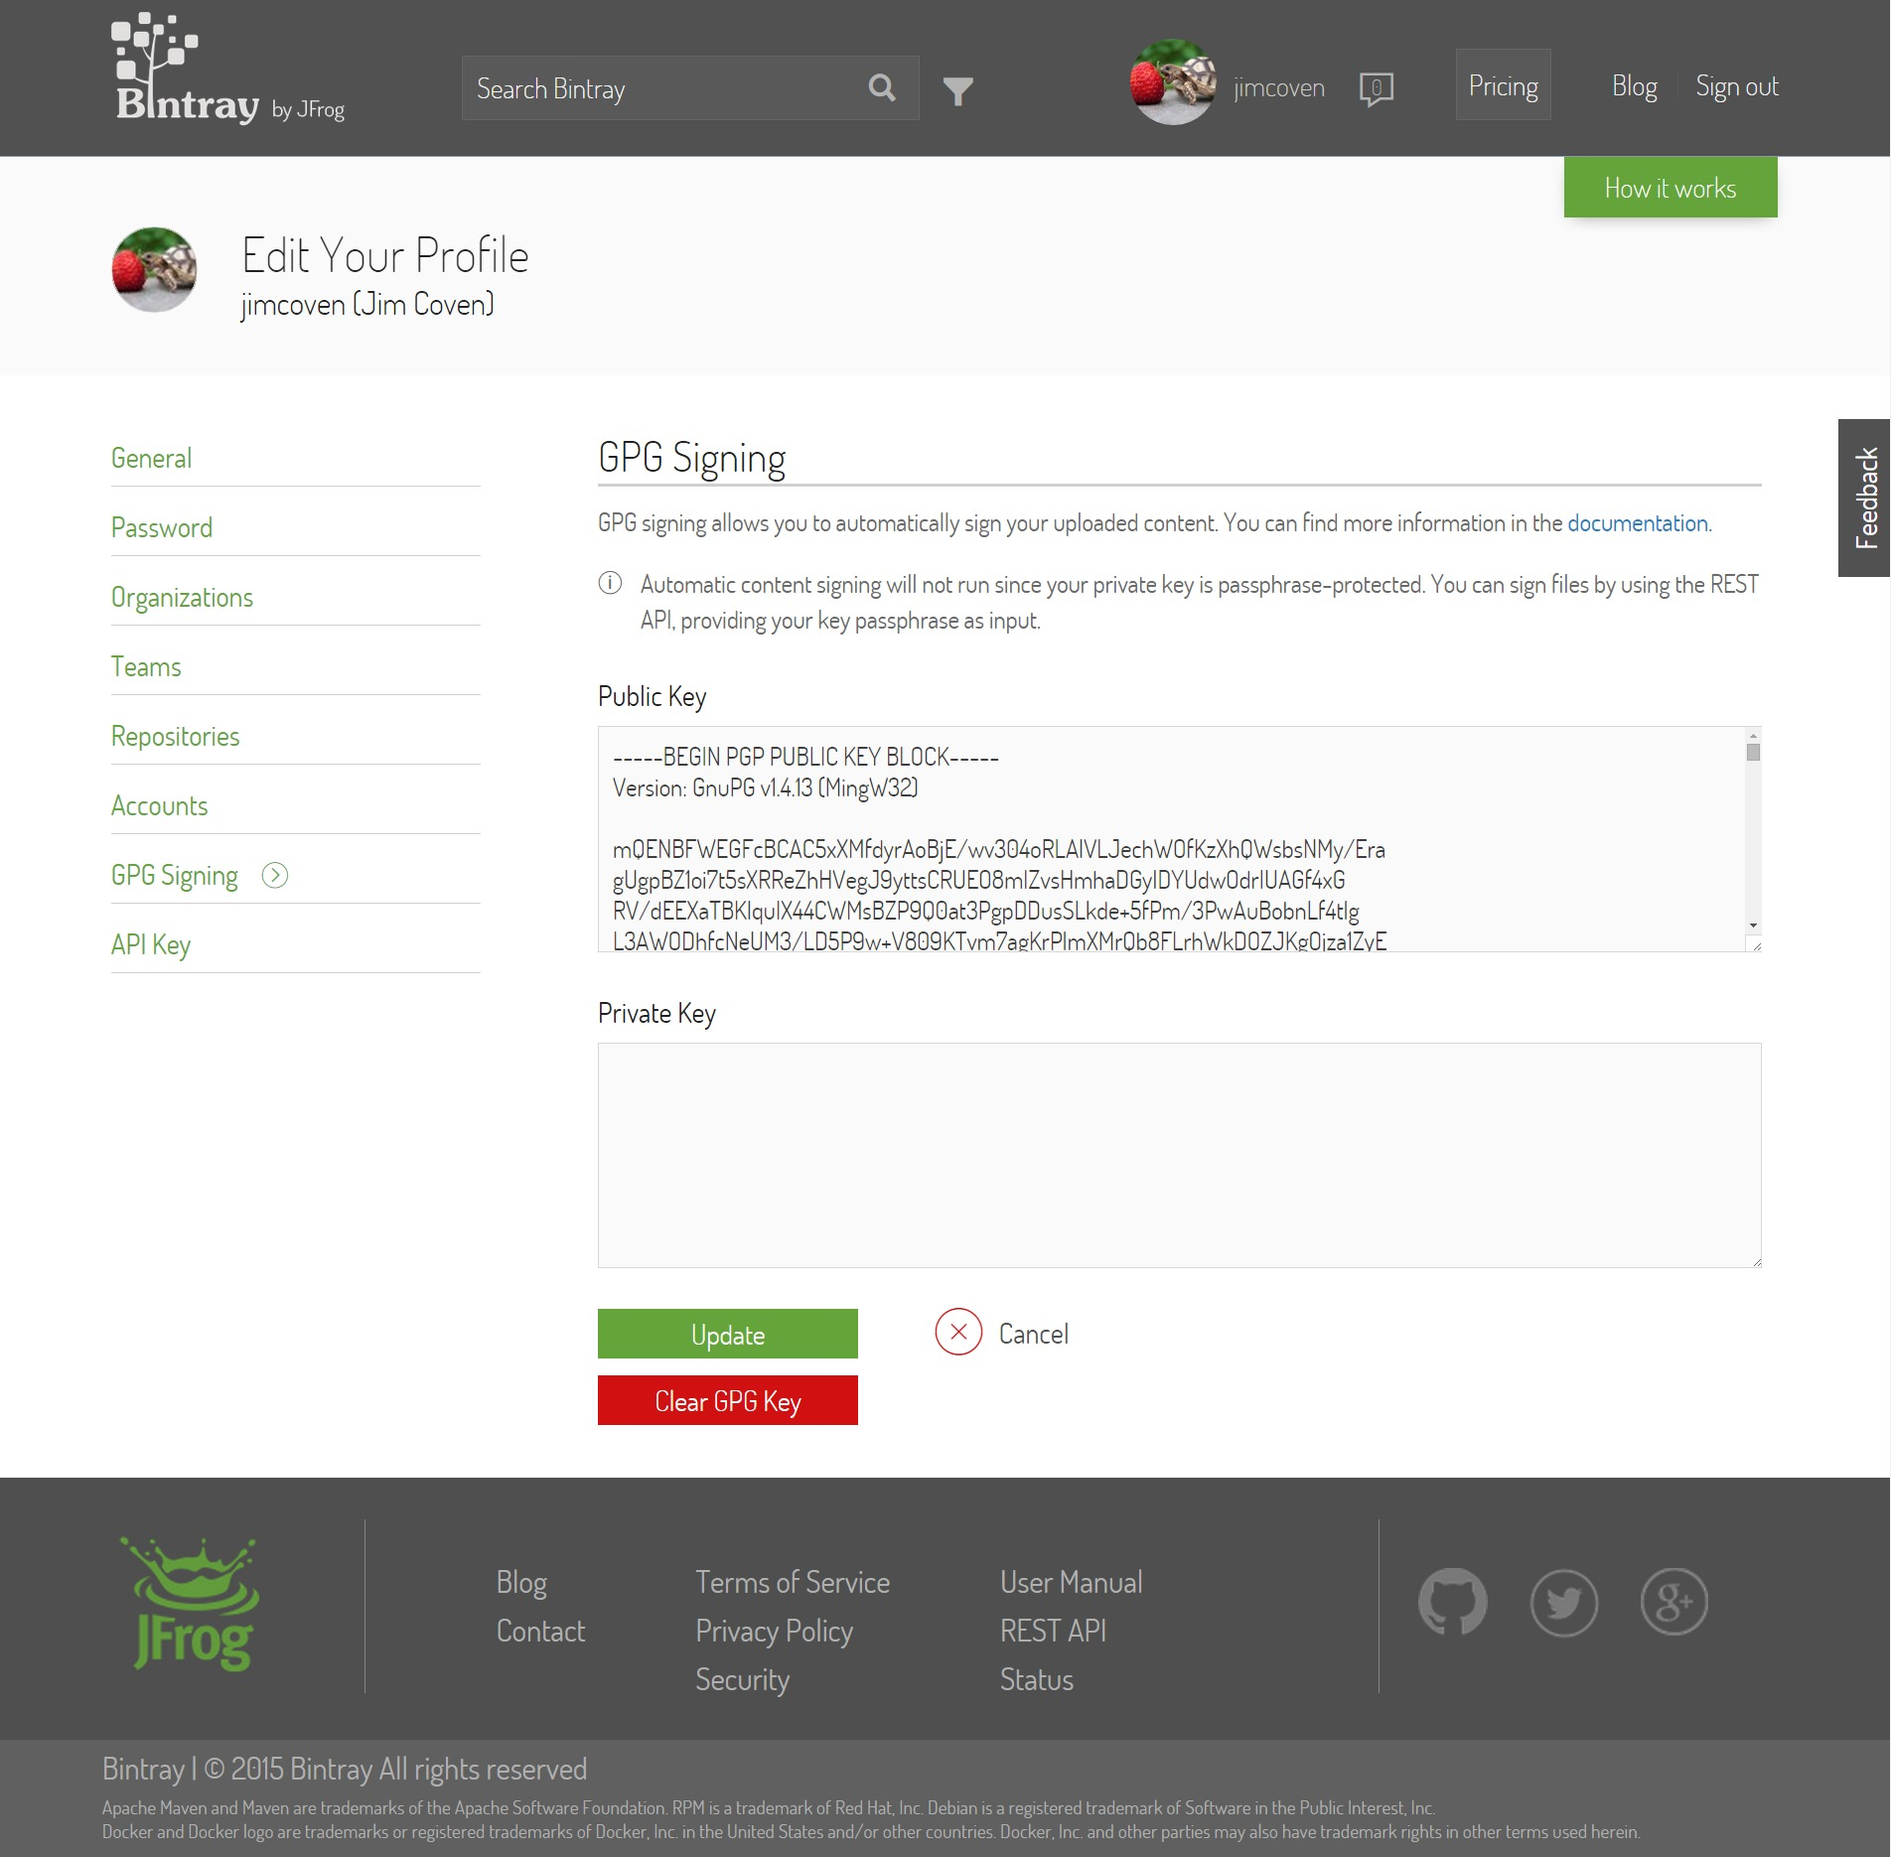
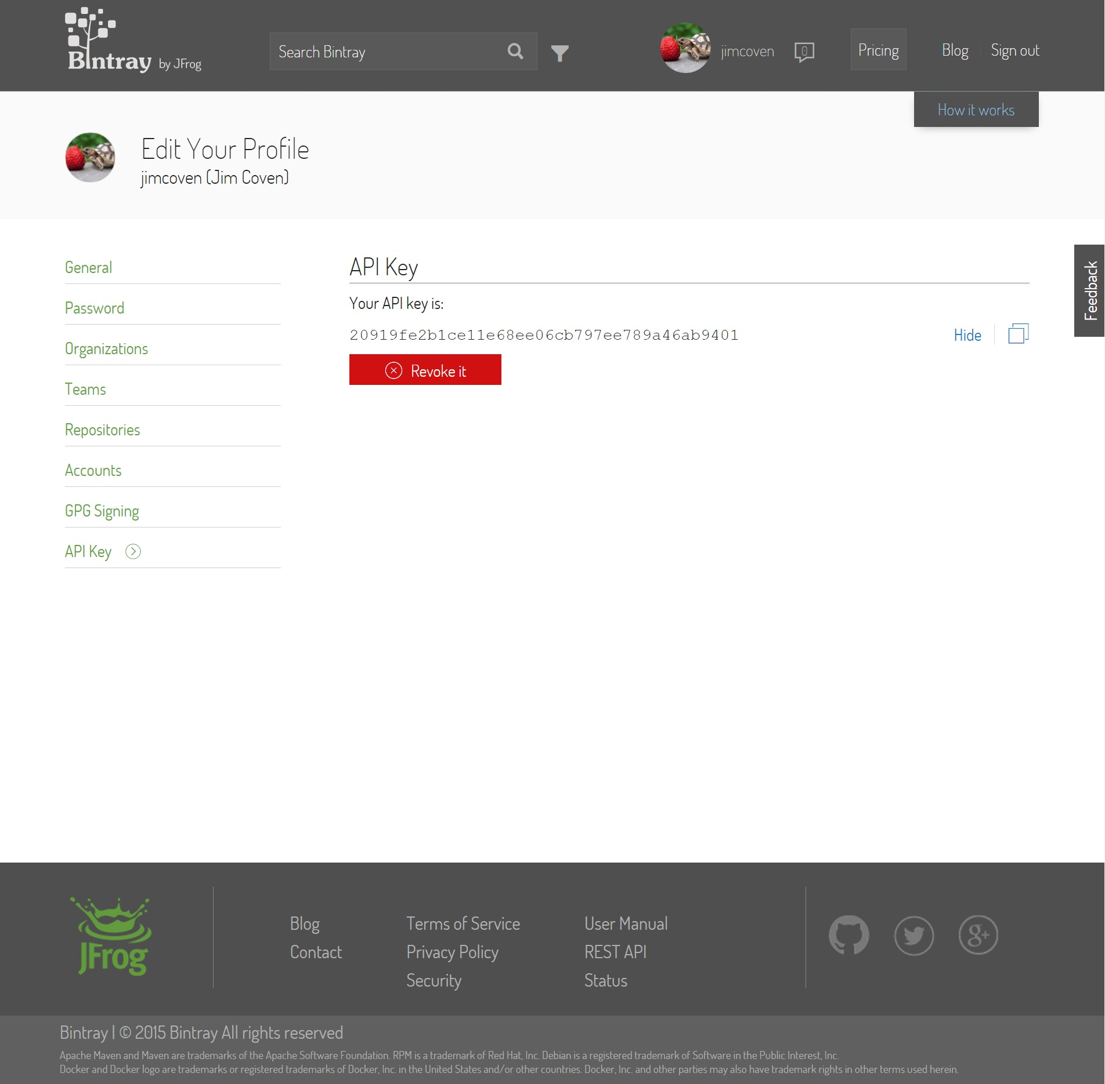

Slide 2
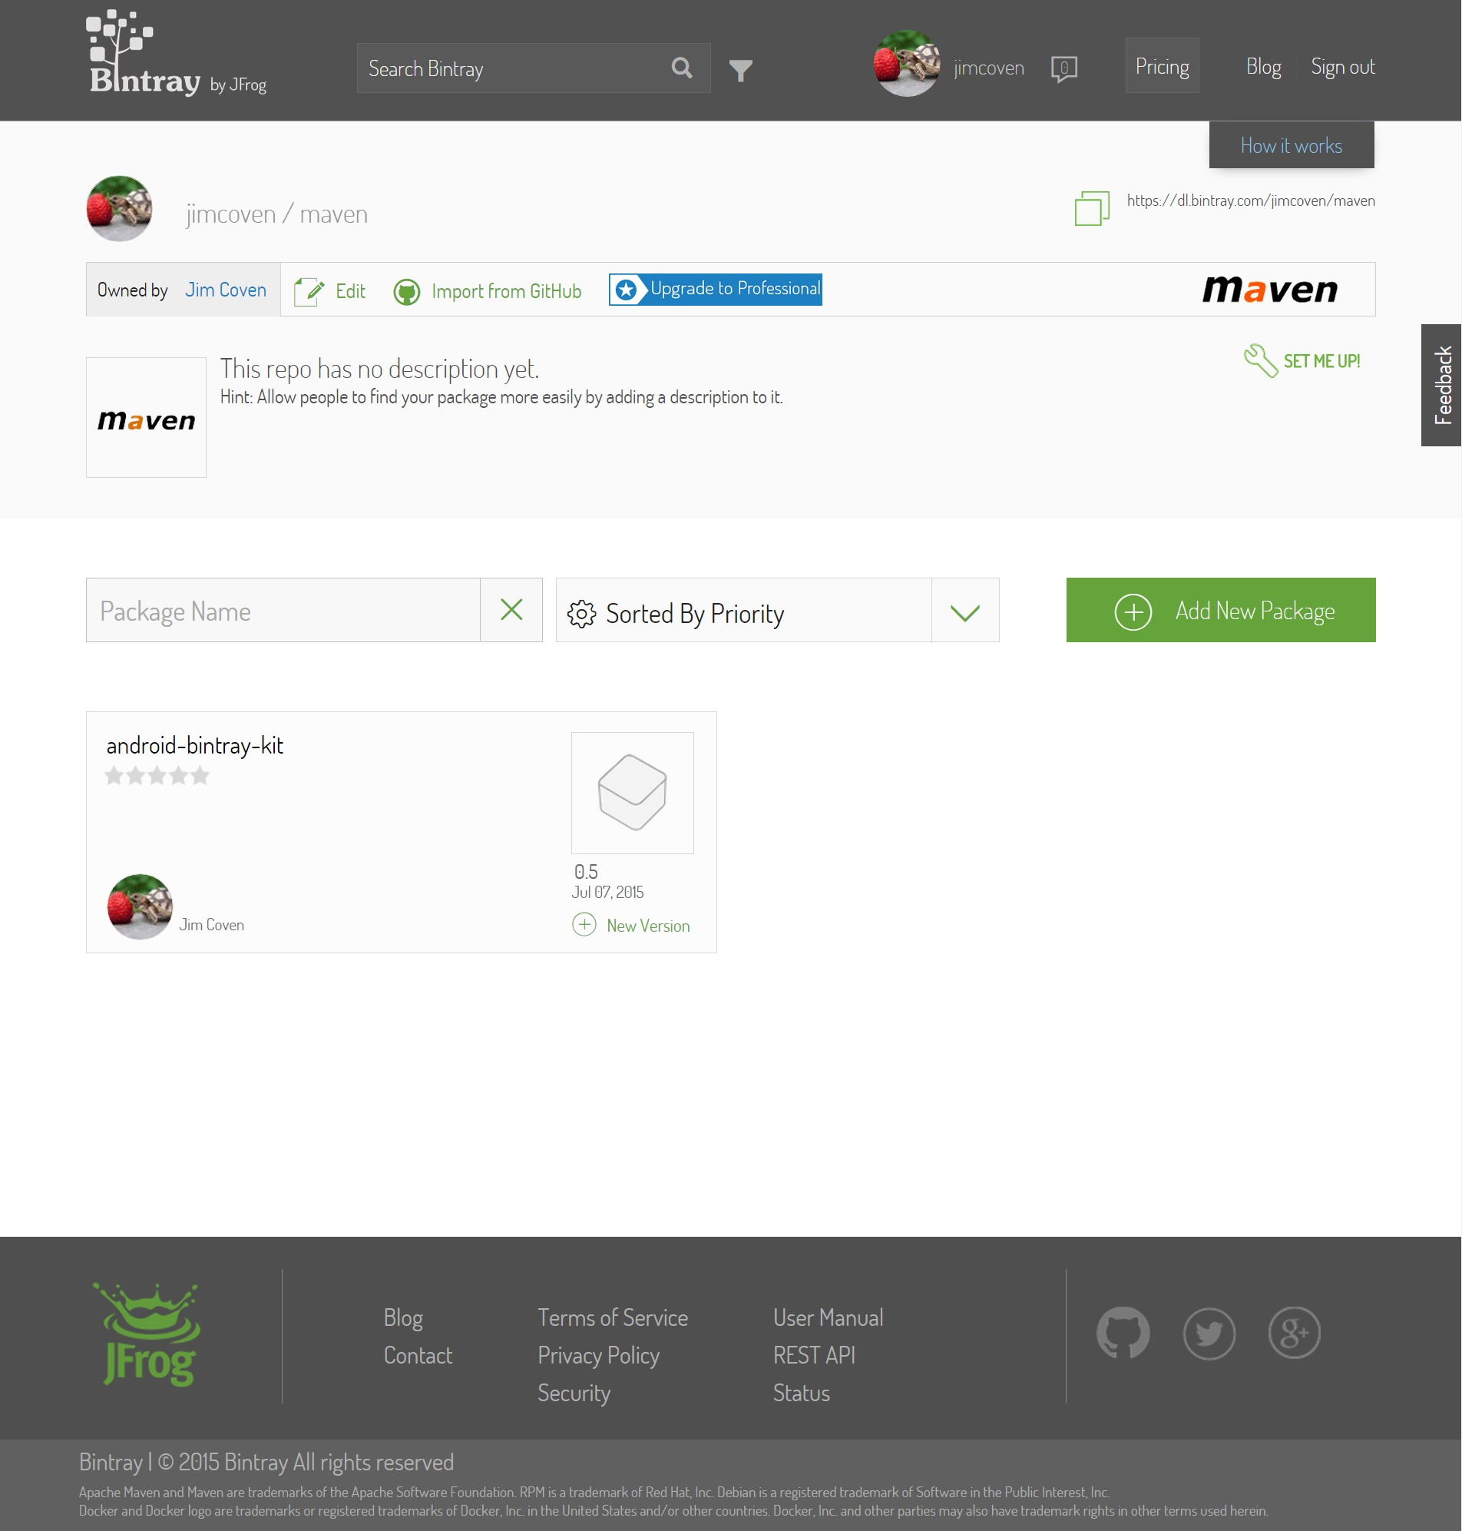
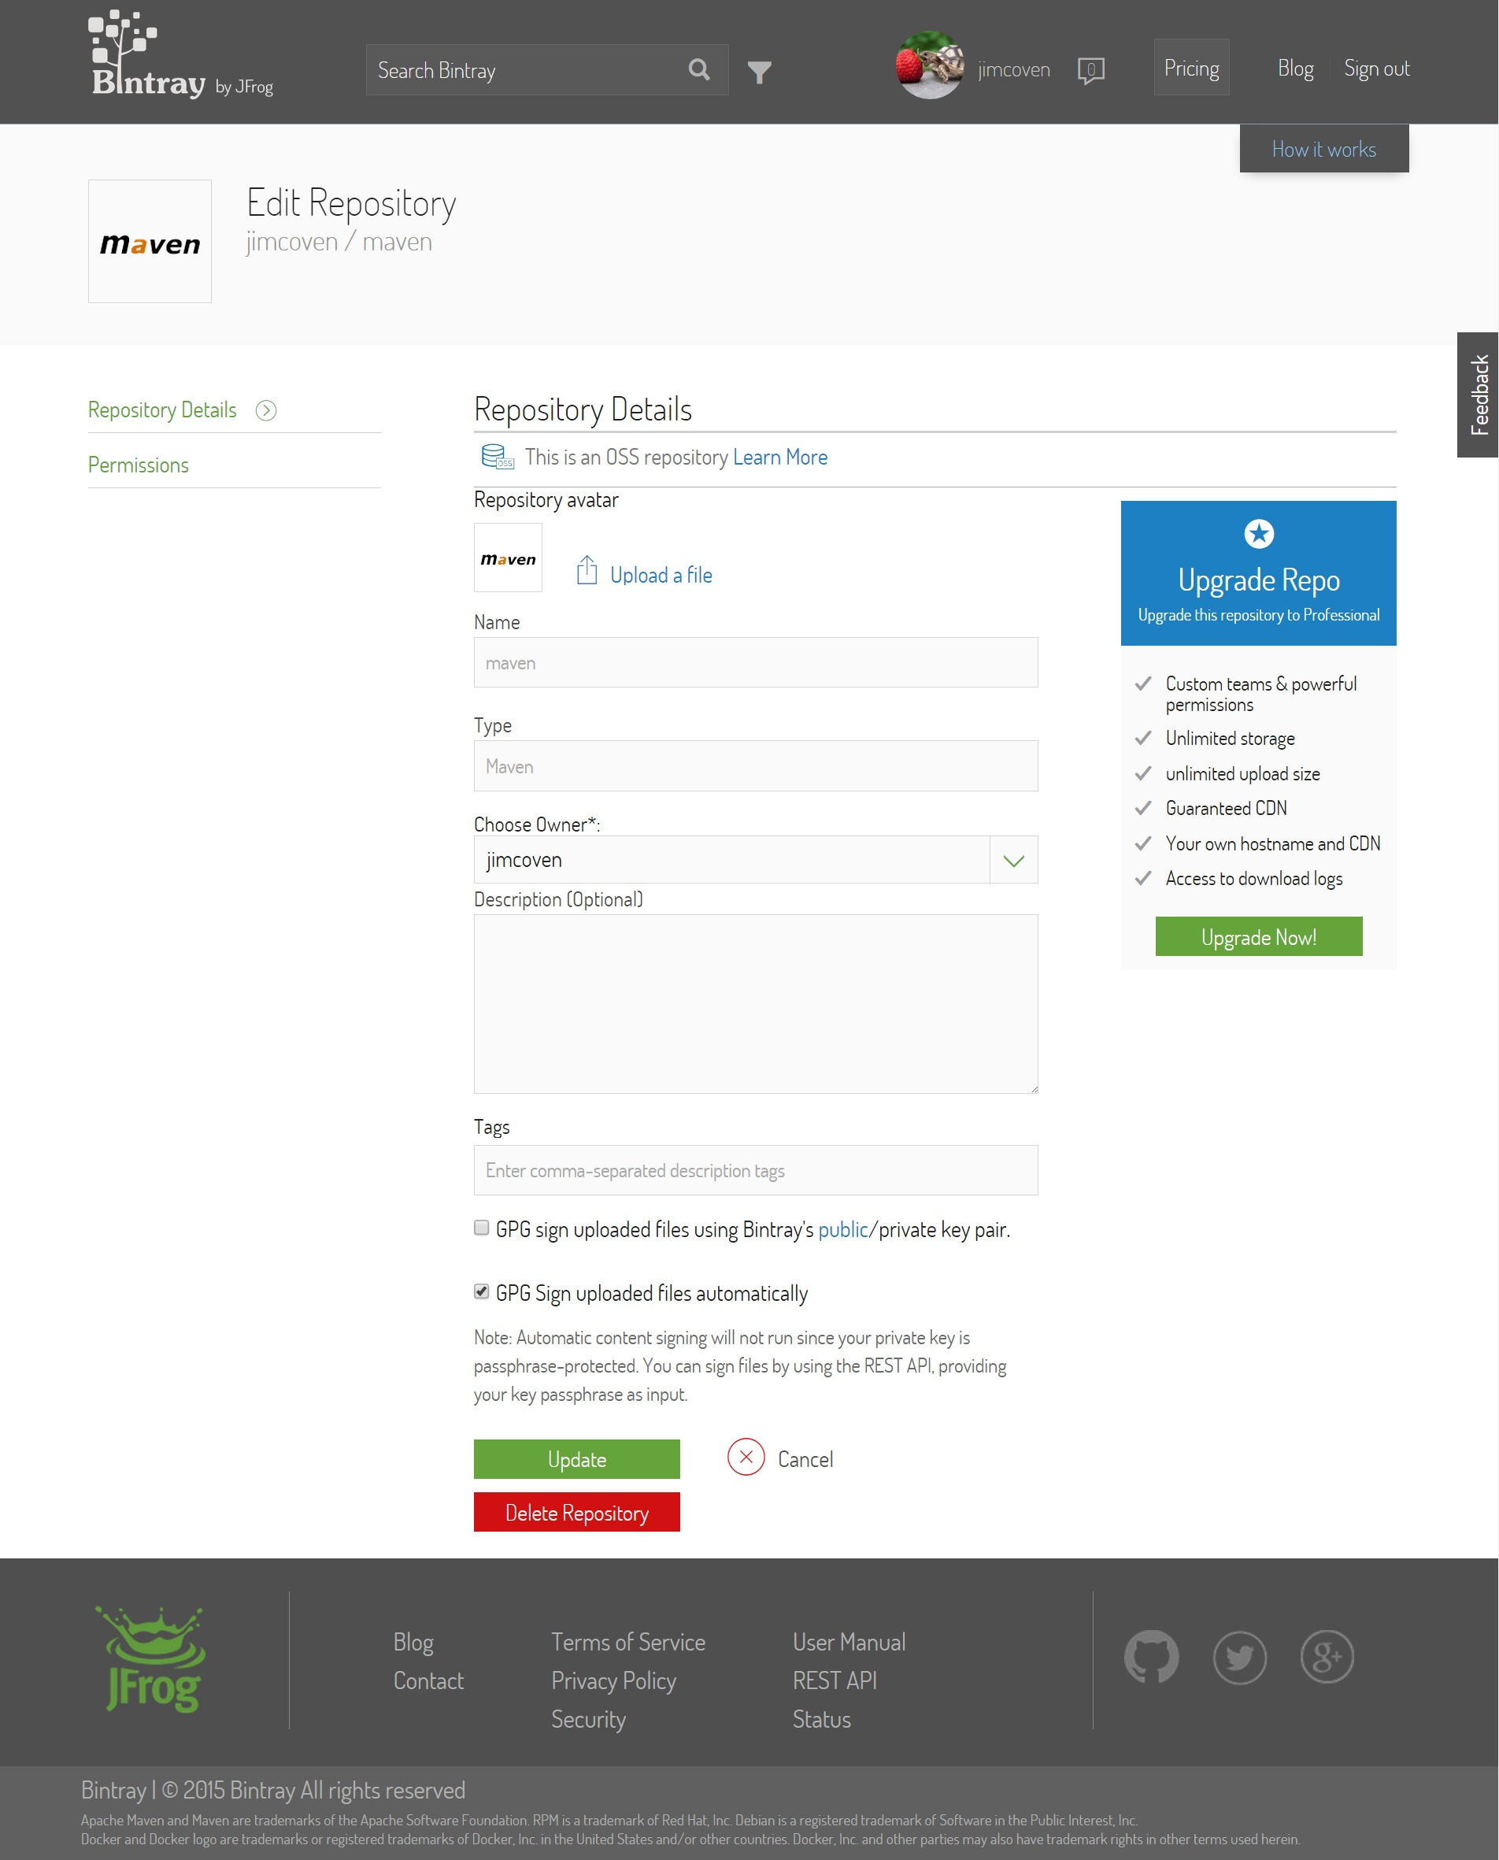

Slide 3
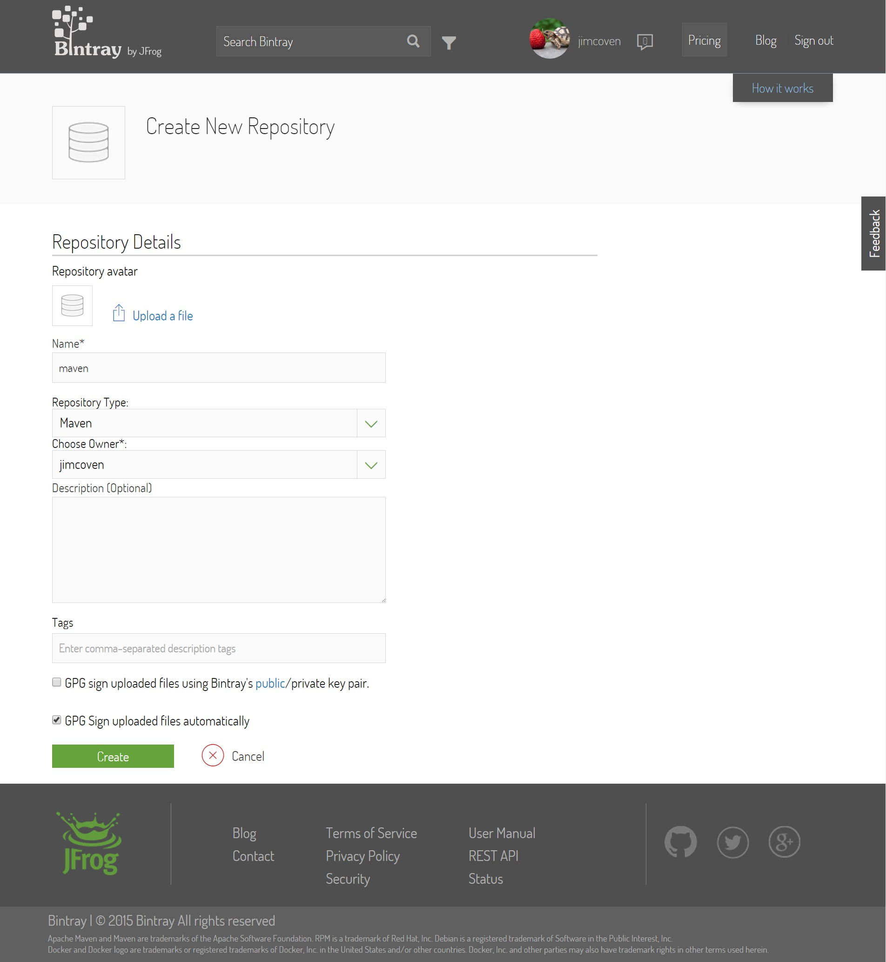

Slide 4
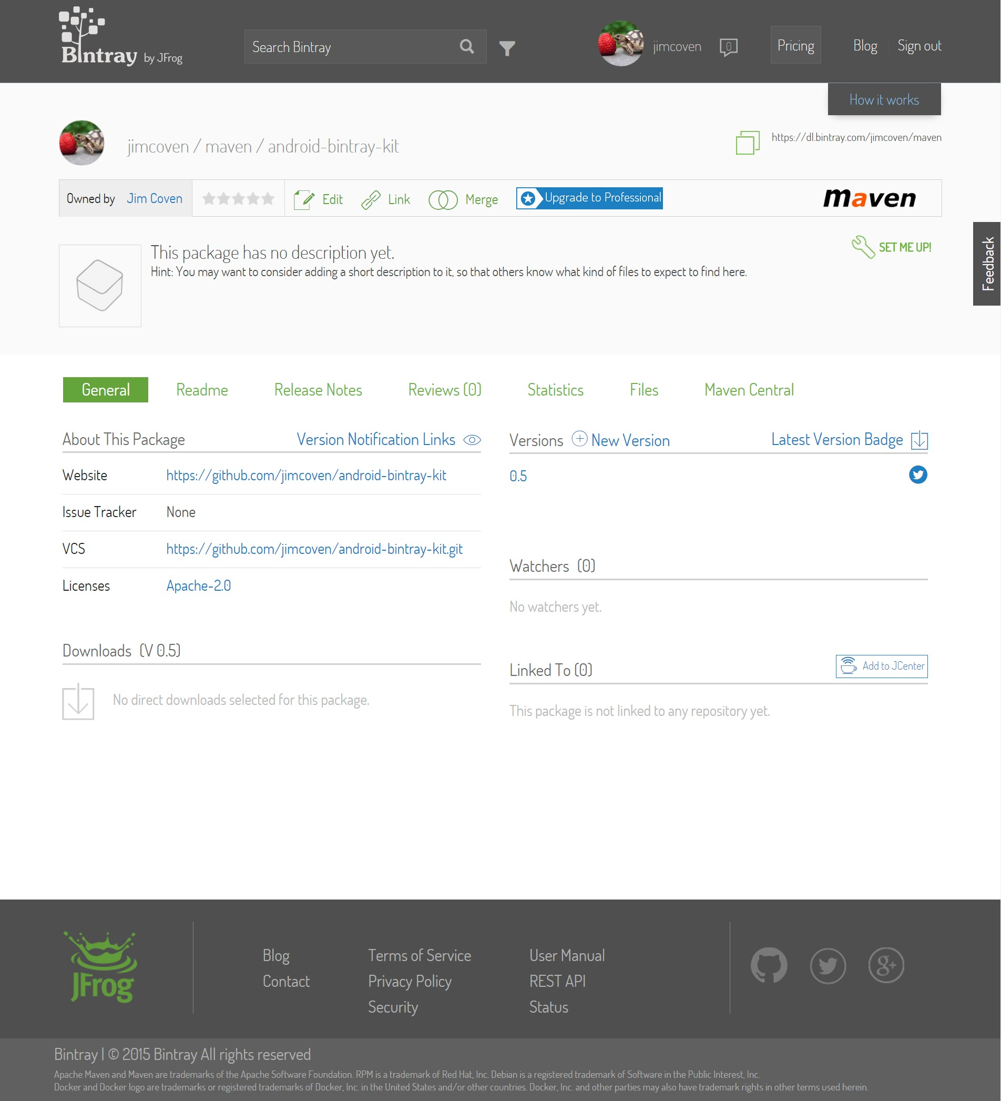
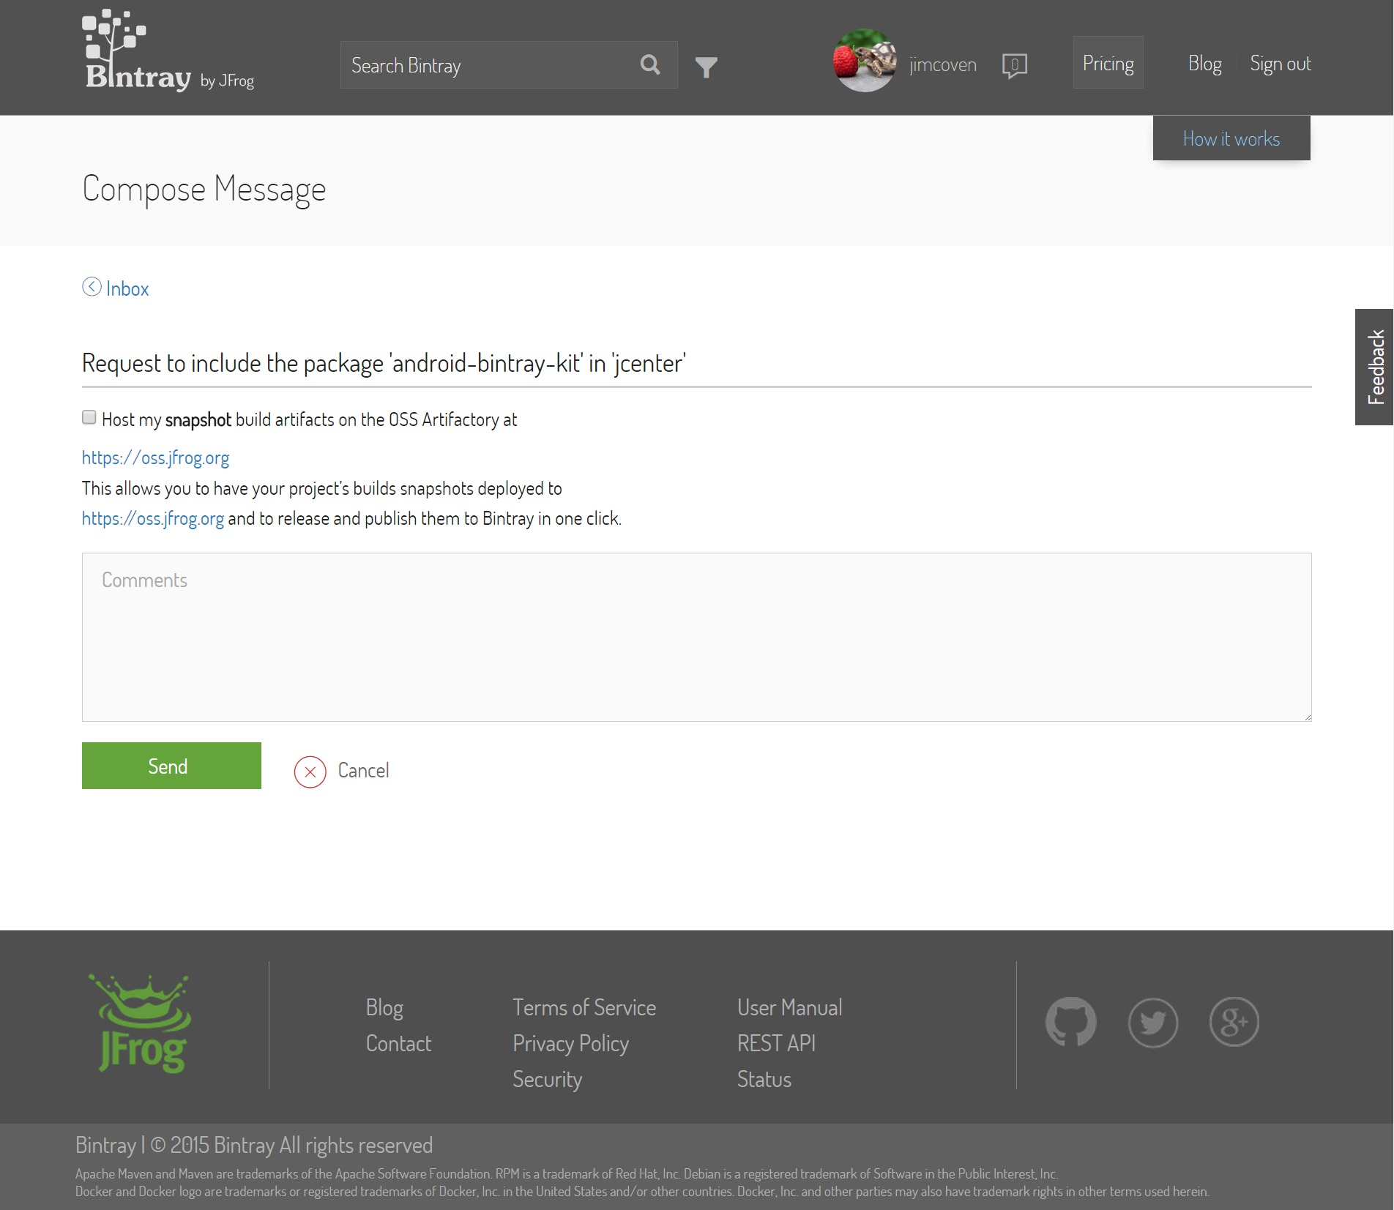

Slide 5
START PUBLISH
(bintray-publish.bat/sh)
WHAT TO BUILD?
(bintray-aar-settings.gradle)
START BUILD
(build.gradle)
BUILD MOD_LIBRARY
(mod_lib/build.gradle)
WHAT TO
AUTH?
(bintray.auth)
A. Set Auth Params
B. Set Minimum Publish Params
C. Set Additional Pom.xml Params
D. Perform
Android Build
PUBLISH
(bintray-aar-publish.gradle)
END

Slide 6
